Slide 1
Embedded OS
- User Space Initialization
2021年12月
Embedded System

Slide 2
6 User Space Initialization
6.1 Root File System
6.2 Kernel’s Last Boot Steps
6.3 The init Process
6.4 Initial RAM Disk
6.5 Using initramfs
6.6 Shutdown
6.7 Summary
Embedded System

Slide 3
User Space Initialization
In Chapter 2, “The Big Picture,” we pointed out that the Linux kernel itself is but a small part of any embedded Linux system. After the kernel has initialized itself, it must mount a root file system and execute a set of developerdefined initialization routines.
In this chapter, we examine the details of post kernel system initialization.

Slide 4
6.1 Root File System
Linux, like many other advanced operating systems, requires a root file system to realize the benefits of its services.
The root file system refers to the file system mounted at the base of the file system hierarchy, designated simply as /.
even a small embedded Linux system typically mounts several file systems on different locations within the file system hierarchy.
The root file system is simply the first file system mounted at the top of the file system hierarchy.
Linux expects the root file system to contain programs and utilities to boot the system, initialize services such as networking and a system console, load device drivers, and mount additional file systems.

Slide 5
6.1.1 FHS: File System Hierarchy Standard
Several kernel developers authored a standard governing the organization and layout of a UNIX file system
The File System Hierarchy Standard (FHS) establishes a minimum baseline of compatibility between Linux distributions and application programs

Slide 6
6.1.2 File System Layout
many embedded systems developers create a very small root file system on a bootable device (such as Flash memory). Later, a larger file system is mounted from another device, perhaps a hard disk or network file system (NFS) server
In fact, it is not uncommon to mount a larger root file system on top of the original small one.

Slide 7
File System Layout
A simple Linux root file system might contain the following top-level directory entries:
.
|
|--bin
|--dev
|--etc
|--home
|--lib
|--sbin
|--usr
|--var
|--tmp

Slide 8
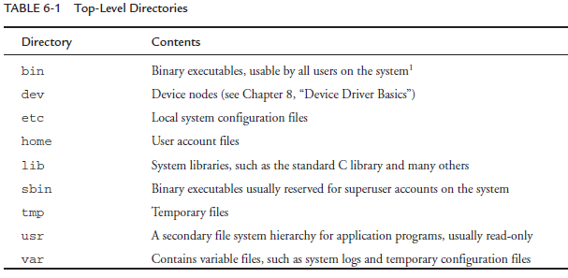

File System Layout

Slide 9
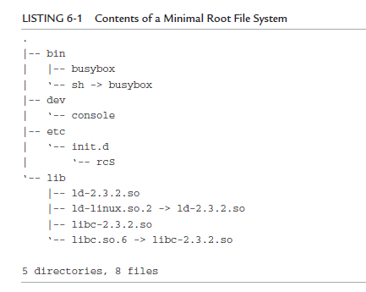
6.1.3 Minimal File System
Listing 6-1 is the output from the tree command on this minimal root file system.

Slide 10
busybox
This root configuration makes use of busybox, a popular and aptly named toolkit for embedded systems.
busybox is a stand-alone binary that supports many common Linux command-line utilities.
busybox is so pertinent for embedded systems

Slide 11
Minimal File System
This simple root file system produces a fully functional system. On the ARM/XScale board on which this was tested, the size of this small root file system was about 1.7MB.
It is interesting to note that more than 80 percent of that size is contained within the C library itself.

Slide 12
6.1.4 The Embedded Root FS Challenge
Difficult to fit your applications and utilities onto a single Flash memory device. One of the single largest reasons Linux continues to grow in popularity as an embedded OS is the huge and growing body of Linux application software.
Trimming a root file system to fit into a given storage space requirement can be daunting.

Slide 13
6.1.5 Trial-and-Error Method
Until recently, the only way to populate the contents of your root file system was to use the trial-and-error method
rpm has reasonable dependency resolution within given packages, but it is complex and involves a significant learning curve

Slide 14
6.1.6 Automated File System Build Tools
The leading vendors of embedded Linux distributions ship very capable tools designed to automate the task of building root file systems in Flash or other devices. These tools usually are graphical in nature, enabling the developer to select files by application or functionality
Some open source build tools automate the task of building a working root file system. Some of the more notable include bitbake from the OpenEmbedded project (www.openembedded.org/) and buildroot (http://buildroot.uclibc.org/.)

Slide 15
6.2 Kernel’s Last Boot Steps
LISTING 6-2 Final Boot Steps from main.c
...
if (execute_command) {
run_init_process(execute_command);
printk(KERN_WARNING “Failed to execute %s. Attempting “
“defaults...\n”, execute_command);
LISTING 6-2 Continued
}
run_init_process(“/sbin/init”);
run_init_process(“/etc/init”);
run_init_process(“/bin/init”);
run_init_process(“/bin/sh”);
panic(“No init found. Try passing init= option to kernel.”);

Slide 16
Kernel’s Last Boot Steps
Notice a key ingredient of these processes: They are all programs that are expected to reside on a root file system that has a structure similar to that presented in Listing 6-1. Therefore, we know that we must at least satisfy the kernel’s requirement for an init process that can execute within its own environment.
In looking at Listing 6-2, this means that at least one of the run_init_process() function calls must succeed.
if none of these four programs succeeds, the booting kernel issues the dreaded panic() function call and dies right there.

Slide 17
6.2.1 First User Space Program
On most Linux systems, /sbin/init is spawned by the kernel on boot.
Effectively, this becomes the first user space program to run. To review, this is the sequence:
  1. Mount the root file system.
  2. Spawn the first user space program, which, in this discussion, becomes /sbin/init.
from Listing 6-1, the first three attempts at spawning a user space process would fail, because we did not provide an executable file called init anywhere on the file system. Recall from Listing 6-1 that we had a soft link called sh that pointed back to busybox

Slide 18
6.2.2 Resolving Dependencies
For every process you place on your root file system, you must alsosatisfy its dependencies. Most processes have two categories of dependencies: those that are needed to satisfy unresolved references within a dynamically linked executable, and external configuration or data files that an application might need.
To run init, we need to satisfy its library dependencies. A tool has been developed for this purpose: ldd.
  $ ppc_4xx-ldd init
  libc.so.6 => /opt/eldk/ppc_4xxFP/lib/libc.so.6
  ld.so.1 => /opt/eldk/ppc_4xxFP/lib/ld.so.1

Slide 19
6.2.3 Customized Initial Process
It is worth noting that the system user can control which initial process is executed at startup. This is done by a kernel command-line parameter.
console=ttyS0,115200 ip=bootp root=/dev/nfs init=/sbin/myinit
Specifying init= in the kernel command line in this way, you must provide a binary executable on your root file system in the /sbin directory called myinit
This would be the first process to gain control at the completion of the kernel’s boot process.

Slide 20
6.3 The init Process
Unless you are doing something highly unusual, you will never need to provide a customized initial process, because the capabilities of the standard init process are very flexible
The init program, together with a family of startup scripts that we will examine shortly, implement what is commonly called System V Init, from the original UNIX System V that used this schema.

Slide 21
The init Process
every process in a running Linux system has a child-parent relationship with another process running in the system. init is the ultimate parent of all user space processes in a Linux system
init provides the default set of environment parameters for all otherprocesses to inherit, such as the initial system PATH.
Its primary role is to spawn additional processes under the direction of a special configuration file. This configuration file is usually stored as /etc/inittab.

Slide 22
The init Process-Runlevel
Runlevels used by init include runlevels from 0 to 6 and a special runlevel called S.
For each runlevel, a set of startup and shutdown scripts is usually provided that define the action a system should take for each runlevel. Actions to perform for a given runlevel are determined by the /etc/inittab configuration file, described shortly.

Slide 23
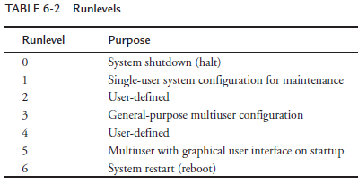
The init Process-Runlevel

Slide 24
The init Process-Runlevel
The runlevel scripts are commonly found under a directory called /etc/rc.d/init.d.
Here you will find most of the scripts that enable and disable individual services

Slide 25
6.3.1 inittab
When init is started, it reads the system configuration file /etc/inittab. This file contains directives for each runlevel, as well as directives that apply to all runlevels

Slide 26
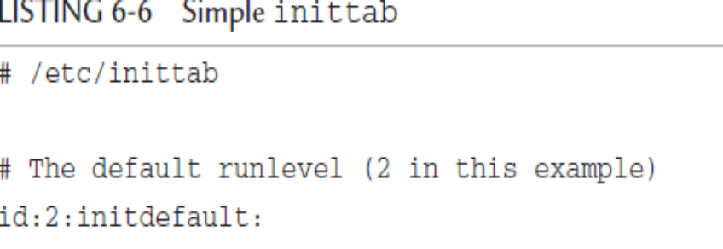
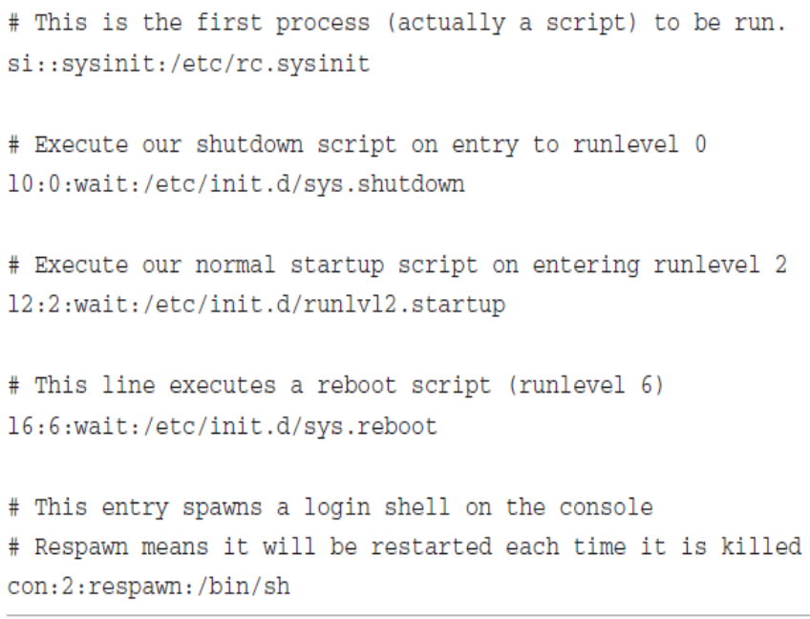
6.3.1 inittab

Slide 27
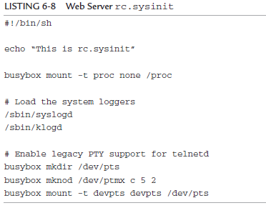
6.3.2 Sample Web Server Startup Script

Slide 28
6.4 Initial RAM Disk
The Linux kernel contains two mechanisms to mount an early root file system to perform certain startup-related system initialization and configuration. First we will discuss the legacy method, the initial ramdisk, or initrd.
The initial RAM disk is a small, self-contained root file system that usually contains directives to load specific device drivers before the completion of the boot cycle.
An initrd is frequently used to load a device driver that is required in order to access the real root file system.

Slide 29
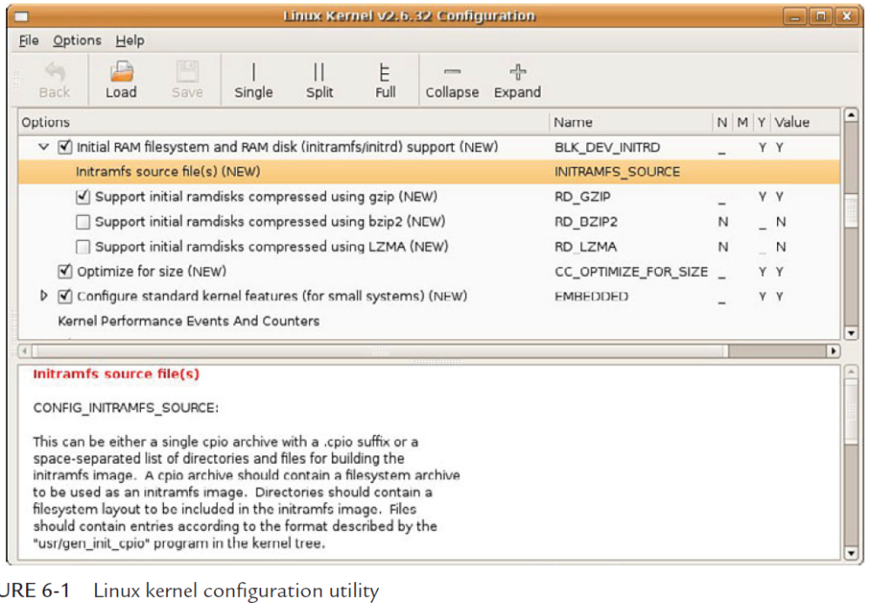

Slide 30
6.4.1 Booting with initrd
To use the initrd functionality, the bootloader gets involved on most architectures to pass the initrd image to the kernel.
console=ttyS0,115200 root=/dev/nfs nfsroot=192.168.1.9:/home/chris/sandbox/omap-target initrd=0x10800000,0x14af47

Slide 31
6.4.2 Bootloader Support for initrd
Let’s look at a simple example based on the popular U-Boot bootloader running on an ARM processor. This bootloader was designed with support for directly booting the Linux kernel.

Slide 32
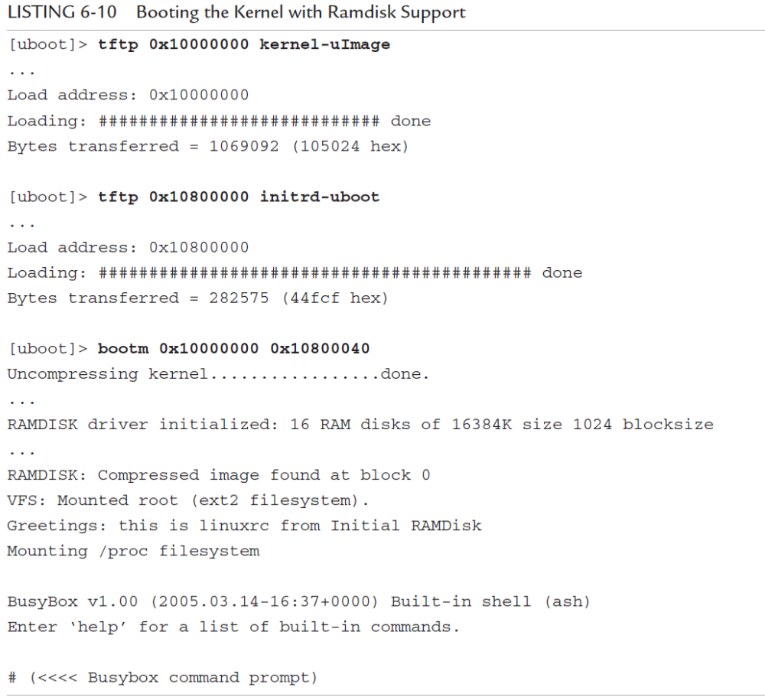

Slide 33
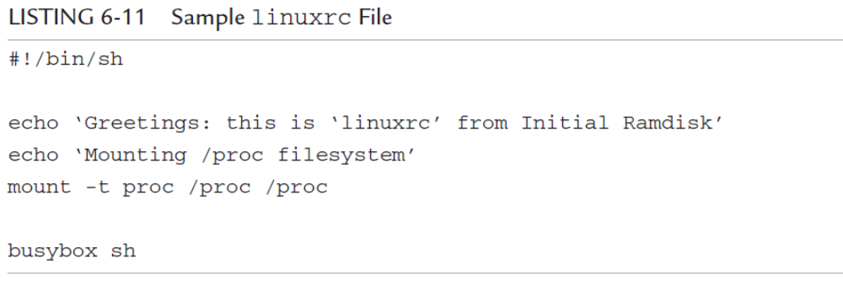
6.4.3 initrd Magic: linuxrc
The magic of initrd comes from the contents of a special file within the initrd image. When the kernel mounts the initial ramdisk, it looks for a specific file called linuxrc. It treats this file as a script file and proceeds to execute the commands contained therein. This mechanism enables the system designer to specify the behavior of initrd.
Notes:
mount command: mount -t type device directory

Slide 34
6.4.4 The initrd Plumbing
As part of the Linux boot process, the kernel must locate and mount a root file system.
Late in the boot process, the kernel decides what and where to mount in a function called prepare_namespace(), which is found in .../init/do_mounts.c.
When the linuxrc script has completed execution, the kernel unmounts the initrd and proceeds with the final stages of system boot.
If the kernel command line contains a root= parameter specifying a ramdisk (root=/dev/ram0, for example), This means that you can have a Linux system with initrd as the only root file system.

Slide 35
6.4.5 Building an initrd Image
Creating a proper initrd image is even more challenging, because it needs to be small and specialized. This section examines initrd requirements and file system contents.
it is very small indeed; it takes up a little more than 500KB in uncompressed form. Since it is based on busybox, it has many capabilities. Because busybox is statically linked for this exercise, it has no dependencies on any system libraries

Slide 36
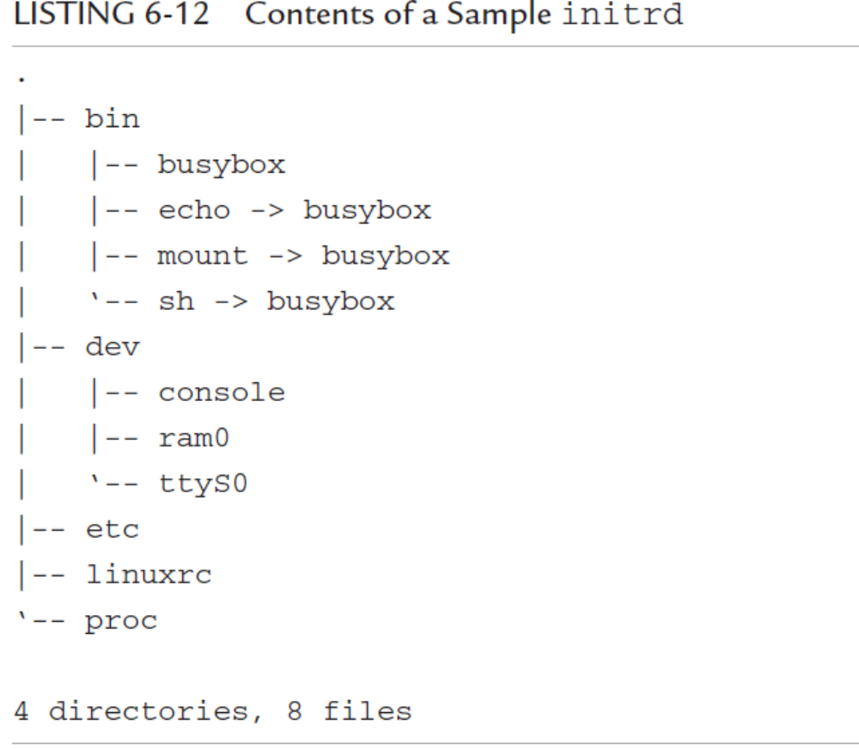

Slide 37
6.5 Using initramfs
initramfs is the preferred mechanism for executing early user space programs. It is conceptually similar to initrd, as described in the preceding section
It is enabled using the same configuration selections as shown in Figure 6-1.But,it differs in significant ways from the initrd mechanism.
The technical implementation details differ significantly between initrd and initramfs
  initramfs is loaded before the call to do_basic_setup(),which provides a mechanism for loading firmware for devices before its driver has been loaded.
  initramfs is a cpio archive, whereas initrd is a gzipped file system image

Slide 38
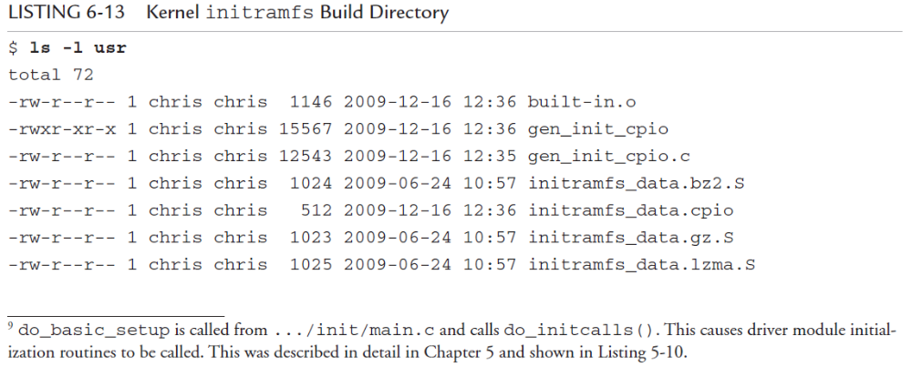
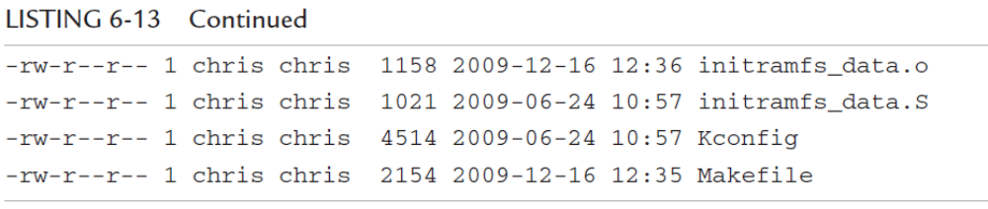
Using initramfs

Slide 39
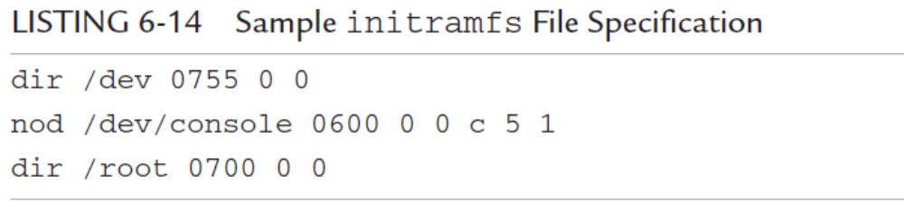
Using initramfs
A build script in .../scripts called gen_initramfs_list.sh defines a default list of files that will be included in the initramfs archive. The default for recent Linux kernels looks like Listing 6-14.

Slide 40
6.5.1 Customizing initramfs
There are two ways to customize the initramfs for your particular requirements.Either create a cpio archive with your required files, or specify a list of directories and files whose contents are merged with the default created by gen_initramfs_list.sh.
You specify a source for your initramfs files via the kernel-configuration facility. Enable INITRAMFS_SOURCE in your kernel configuration, and point it to a location on your development workstation

Slide 42
查看initramfs的内容
# mkdir initrd
# cd intrd
# cp /boot/initrd.img initrd.img
# gunzip initrd.img
# cpio -i --make-directories < initrd.img
#
创建initramfs
mkinitramf
# mkinitramfs -o /boot/initrd.img 2.6.2
Note: 2.6.25是需要创建initramfs的kernel版本号，如果是给当前kernel制作initramfs，可以用uname -r查看当前的版本号。提供kernel版本号的主要目的是为了在initramfs中添加指定kernel的驱动模块。mkinitramfs会把/lib/modules/${kernel_version}/ 目录下的一些启动会用到的模块添加到initramfs中。
update-initramfs
更新当前kernel的initramfs
# update-initramfs -u
在添加模块时，initramfs tools只会添加一些必要模块，用户可以通过在/etc/initramfs-tools/modules文件中加入模块名称来指定必须添加的模块。
命令：mkinitramfs, update-initramfs
mkinitcpio
在Arch Linux中，有一个新一代的initramfs制作工具。相对于老的mkinitrd和mkinitramfs，它有以下很多优点。查看详细《使用mkinitcpio》。

Slide 43
6.6 Shutdown
Improper shutdown can affect startup times and can even corrupt certain file system types
Each embedded project will likely have its own shutdown strategy. What works for one might or might not work for another.
Several Linux utilities are available to assist in the shutdown process, including the shutdown, halt, and reboot commands. Of course, these must be available for your chosen architecture.
A shutdown script should terminate all user space processes, which results in closing any open files used by those processes. If init is being used, issuing the command init 0 halts the system.

